Slide 1
Statistical Engineering: Synergies with Established Engineering Disciplines
Susan O. Schall, PhD
Founder & Lead Consultant, SOS Consulting

Slide 2
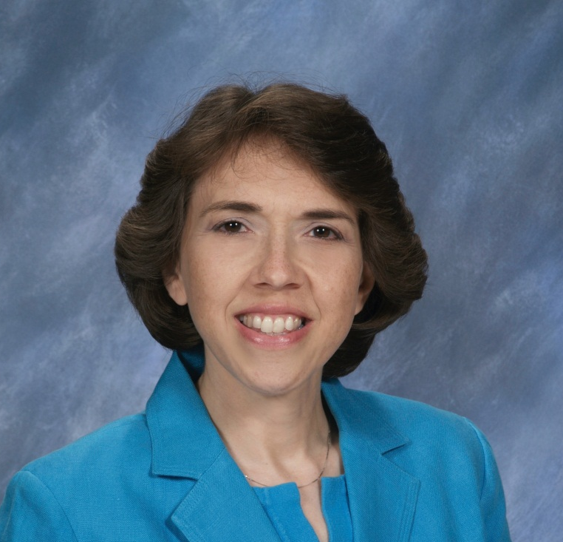
Susan O. Schall, PhD
Founder & Lead Consultant of SOS Consulting, LLC with clients in the chemical, food & beverage, automotive, industrial supply, education, and printing industries.
Creator of COMPETE program to transform small-to-medium US manufacturing workplaces into places that work for all to flourish
Over 30 years experience delivering improved performance using engineering, statistical and process improvement methodologies.
ASQ Certified Quality Engineer, Certified Manager of Quality/Organizational Excellence, and Six Sigma Master Black Belt.
Malcolm Baldrige Examiner 2006 and 2008.
ABET volunteer for over 30 years; serving as an IE program evaluator, Engineering Accreditation Commissioner and Representative Board Director.
Prior to consulting, held a variety of technical and leadership roles at RR Donnelley, GE Lighting, DuPont and Eastman Kodak.
B.S. in Mathematics from SUNY, Fredonia; B.S., M.S., and Ph.D. in Industrial Engineering from Penn State University.

Slide 3
In Memory: Charles H. Schall, Sr (June 8, 1897 – October 29, 1993)

Slide 4
Presentation Objectives
Compare Statistical engineering to the established engineering disciplines and identify similarities
Share personal experience integrating statistical engineering
Explore potential of Statistical Engineering to help solve large unstructured engineering challenges

Slide 5
What is Engineering?
Webster’s Dictionary defines engineering as the “application of mathematical and scientific principles to practical ends, as the design, construction, and operation of economical and efficient structures, equipment, and systems.”
Engineers Invent, Design, Build, Solve, and Improve
Engineers solve problems
Notes:
According to Webster’s dictionary, engineering is the “application of mathematical and scientific principles to practical ends, as the design, construction, and operation of economical and efficient structures, equipment, and systems.”
A lot of words.
What it means is engineers invent things, design things, build things, solve problems, and improve products and processes.

Slide 6
Complex Engineering Problem
engineering problems that include one or more of the following characteristics:
involving wide-ranging or conflicting technical issues,
having no obvious solution,
addressing problems not encompassed by current standards and codes,
involving diverse groups of stakeholders,
including many component parts or sub-problems,
involving multiple disciplines or having significant consequences in a range of contexts.” (Engineering Accreditation Criteria, ABET, 2022-23)
MESSY PROBLEMS

Slide 7
Engineering Achievements of the 20th Century
Electrification
Automobile
Airplane
Water Supply & Distribution
Electronics
Radio & Television
Agriculture mechanization
Computers
High Performance materials
Telephone
Air Conditioning
Highways
Internet
Imaging
Household Appliances
Health Technologies
Petroleum & Petrochemical Technologies
Laser & Fiber Optics
Nuclear Technologies

Slide 8
Types of Engineering
Biological - solve problems at interfaces of plant, animal, and microbial systems.
Chemical - use chemistry to create and improve materials.
Civil - design and build structures.
Electrical - design electrical equipment, devices, and electronic systems
(5) Geotechnical - solve problems involving earth materials.
(6) Management - improve operation of integrated systems of people, materials, equipment, and energy.
(7) Mechanical - design and build things mechanical.

Slide 9
General Engineering Body of Knowledge*
College-Level Mathematics
mathematics that requires a degree of mathematical sophistication at least equivalent to that of introductory calculus. Examples include calculus, differential equations, probability, statistics, linear algebra, and discrete mathematics
Basic Sciences –
disciplines focused on knowledge or understanding of the fundamental aspects of natural phenomena. Basic sciences consist of chemistry and physics and other natural sciences including life, earth, and space sciences.
Engineering Science
based on mathematics and basic sciences but carry knowledge further toward creative application needed to solve engineering problems. They provide a bridge between mathematics and basic sciences and engineering practice
Engineering Design
process of devising a system, component, or process to meet desired needs and specifications within constraints. It is an iterative, creative, decision-making process in which the basic sciences, mathematics, and engineering sciences are applied to convert resources into solutions.
30 credits
45 credits
* Engineering Accreditation Criteria, ABET, 2022-23

Slide 10
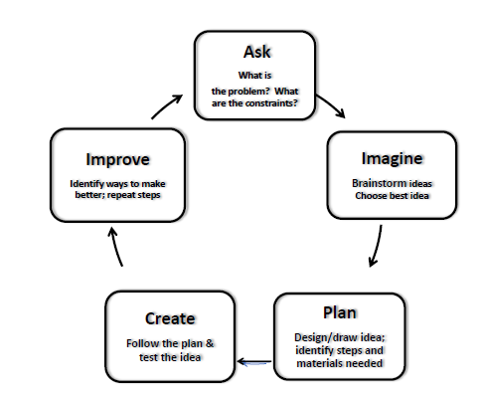
Simplified Engineering Design Process

Slide 11
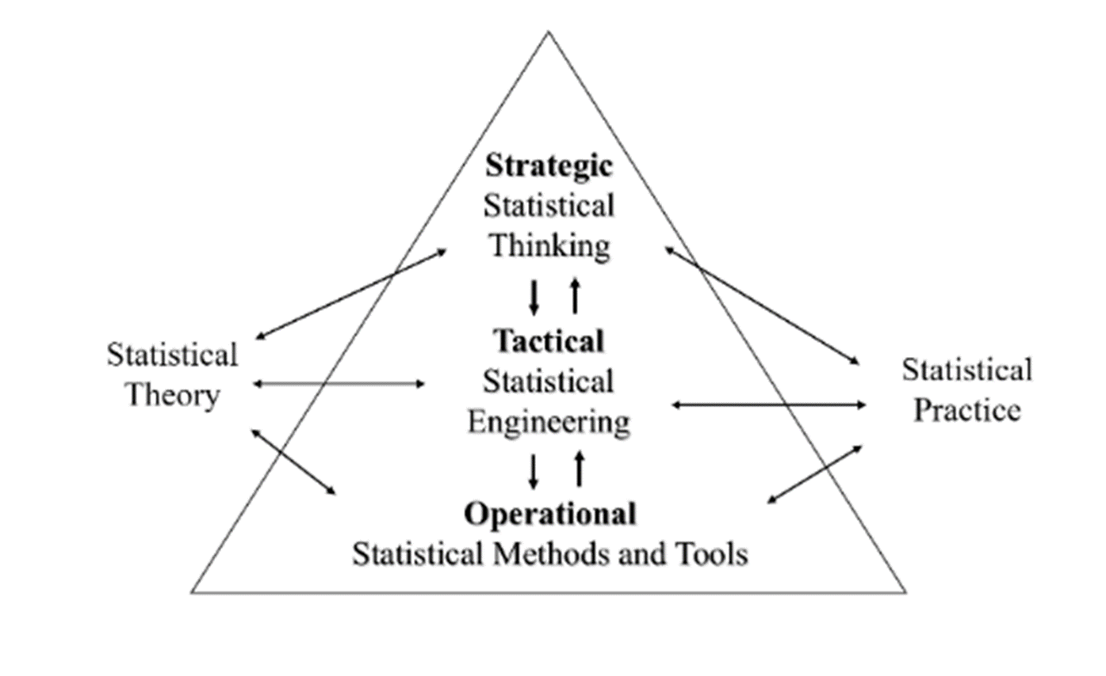
What is Statistical Engineering?
ISEA defines Statistical Engineering* as:
“the study of the systematic integration of statistical concepts, methods, and tools, often with other disciplines, to solve important problems sustainably.”
*from Statistical Engineering Handbook, ISEA member website

Slide 12
What is Statistical Engineering?
The Integrative Role of Statistical Engineering
Human Element
True SMEs from Critical Disciplines
Team Building
Collaboration
Statistical Engineering:
Strategy and Tactics
Better, Faster Solutions to Complex Problems
Statistics, Data Science,
& Business Analytics
Organizational & Behavioral Psychology
ISE, OR, & MS
*from Statistical Engineering Handbook, ISEA member website
Sample Tool Sets
Note: SMEs = subject matter experts; ISE = Industrial and Systems Engineering; OR = Operations Research; MS = Management Science

Slide 13
Statistical Engineering Process*
The Typical Phases of Statistical Engineering Projects
Not historically addressed well in engineering problem-solving
*from Statistical Engineering Handbook, ISEA member website
A “unified approach to statistical analysis and integrating multiple methods…”

Slide 14
Engineering Design Process v SE Process
Engineering Design Process | Statistical Engineering Process
Ask | Define Problem
 | Understand Context
Imagine | Develop Strategy
Plan | Develop Tactics
Create | Execute Tactics
Improve | Identify & Deploy Final Solution

Slide 15
Statistical Engineering ‘Body of Knowledge’*
Data Collection
Data Pedigree/Measurement Systems Analysis
Magnificent Seven Graphical Methods
Probability Distributions
Hypothesis Testing
Model Building
Regression Analysis
Design of Experiments
Statistical Process Control
Leadership
Communication
Teamwork & Collaboration
Change Management
Project Management
*from Statistical Engineering Handbook, ISEA member website

Slide 16
Types of Engineering
Biological - solve problems at interfaces of plant, animal, and microbial systems.
Chemical - use chemistry to create and improve materials.
Civil - design and build structures.
Electrical - design electrical equipment, devices, and electronic systems
(5) Geotechnical - solve problems involving earth materials.
(6) Management - improve operation of integrated systems of people, materials, equipment, and energy.
(7) Mechanical - design and build things mechanical.

Slide 17
Industrial Engineering Body of Knowledge*
Work design and measurement
Operations research and analysis
Engineering economics
Facilities engineering and energy management
Quality and reliability
Ergonomics and human factors
Operations engineering and management
Supply chain management
Engineering management
Safety management
Information engineering
Design and manufacturing engineering
Product design and development
System design and engineering
*Industrial and Systems Engineering Body of Knowledge, Institute of Industrial & Systems Engineers, 2021, https://www.iise.org/details.aspx?id=43631

Slide 18
My Experience Integrating IE and SE
Kodak
DuPont
Consulting
Off-line Product Testing Procedures
Poly Void Defect
Continuous Flow Manufacturing
Supply Chain Analysis
Process Variability Reduction
Schall, Susan O., “Variability Reduction: A Statistical Engineering Approach to Engage Operations Teams in Process Improvement,” Quality Engineering, Vol. 24, 2012, pp.264-279.
Healthy Six Sigma
Schall, Susan O., “Your Opinion: Is Your Organization Healthy Enough for Six Sigma?” Six Sigma Forum Magazine, Vol 14, No. 4, August 2015, pp.26-29.
Bakery Process Control
Fill Weight Management System

Slide 19
NAE Grand Challenges*
Make Solar Energy Economical
Provide Energy for Fusion
Develop Carbon Sequestration
Manage the Nitrogen Cycle
Provide Access to Clean Water
Restore and Improve Urban Infrastructure
Advance Health Informatics
Engineer Better Medicines
Reverse-Engineer the Brain
Prevent Nuclear Terror
Secure Cyberspace
Enhance Virtual Reality
Advance Personalized Learning
Engineer the Tools of Scientific Discovery
SE Can Help Provide Better, Faster Solutions to these Challenges
*Grand Challenges - 14 Grand Challenges for Engineering (engineeringchallenges.org)

Slide 20
Summary
Statistical engineering like the established engineering disciplines is focused on solving ‘messy’ problems
Statistical engineering and established engineering disciplines share a common process for solving problems
Statistical engineering can potentially provide better, faster solutions to solve the Grand Challenges of our planet.

Slide 21
What Questions Do You Have?
Email: susan@execute2compete.com
LinkedIn: www.linkedin.com/in/sosconsult

